Slide 1
FYP Report 1: Presentation
Group Members:
Name: Muhammad Talha.
Roll No: FA20-BCS-007
Name: Hassan Mahmood.
Roll No: SP20-BCS-114
Supervisor:
Dr. Wajahat Mehmood Qazi

Slide 2
Deepfakes Text to Speech (TTS)
DeepCloning.AI

Slide 3
What are DeepFakes ?
As, AI advances, it revolutionize the video, photo and Audio Manipulation.
Realistic Fake Content known as DeepFakes
Deepfakes is a combination of words Deep which is Deep learning and Fake.
While the act of creating fake content is not new, Deepfakes leverage powerful techniques from machine learning and artificial intelligence to manipulate or generate visual and audio content that can more easily deceive.
Example given Below which shows a Deepfake content:

Slide 4

Deep Fake Example

Slide 5
Limitations of Deepfakes
Data Requirements: Lots of Data needed to Develop a Deepfake Content for estimation need data in GBs.
Computation Resources: As, uses Deep Learning Architectures and GANs for creation, so need lots of Computing resources, GPU needed for Training on Dataset.
Technical Expertise: While there exist user-friendly tools for creating basic deepfakes, more advanced and convincing Deepfakes content often requires technical expertise. This limits the accessibility for every individual.
Basic Deepfakes can be created easily using different software which are available now such as Mid Journey, DALL.E, etc. An example is given below

Slide 6
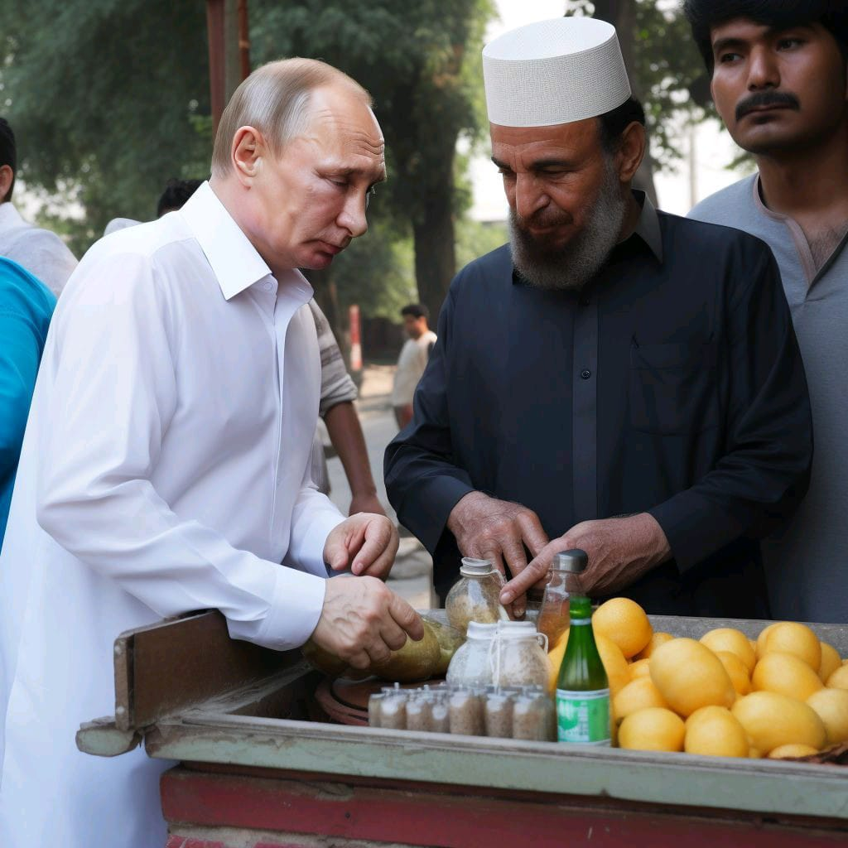
Example of Deep Fakes

Slide 7
Social Impacts of Deepfakes
Ethical Concerns: Deepfakes can be used for malicious purposes, such as creating fake news, spreading disinformation. This raises ethical concerns in Society.
Unauthorized Use: Creating deepfakes without permission can violate individual's privacy and lead to legal consequences. Currently, the lack of regulations for addressing deepfake-related issues can be problematic.
Trust Erosion: The deepfakes content can contribute to a erosion of trust, as people may accept the media content authentic.
Right now, there are many Deepfakes exist on internet, mostly of famous personalities. Majority of them are created for misuse and to promote misguidance.

Slide 8
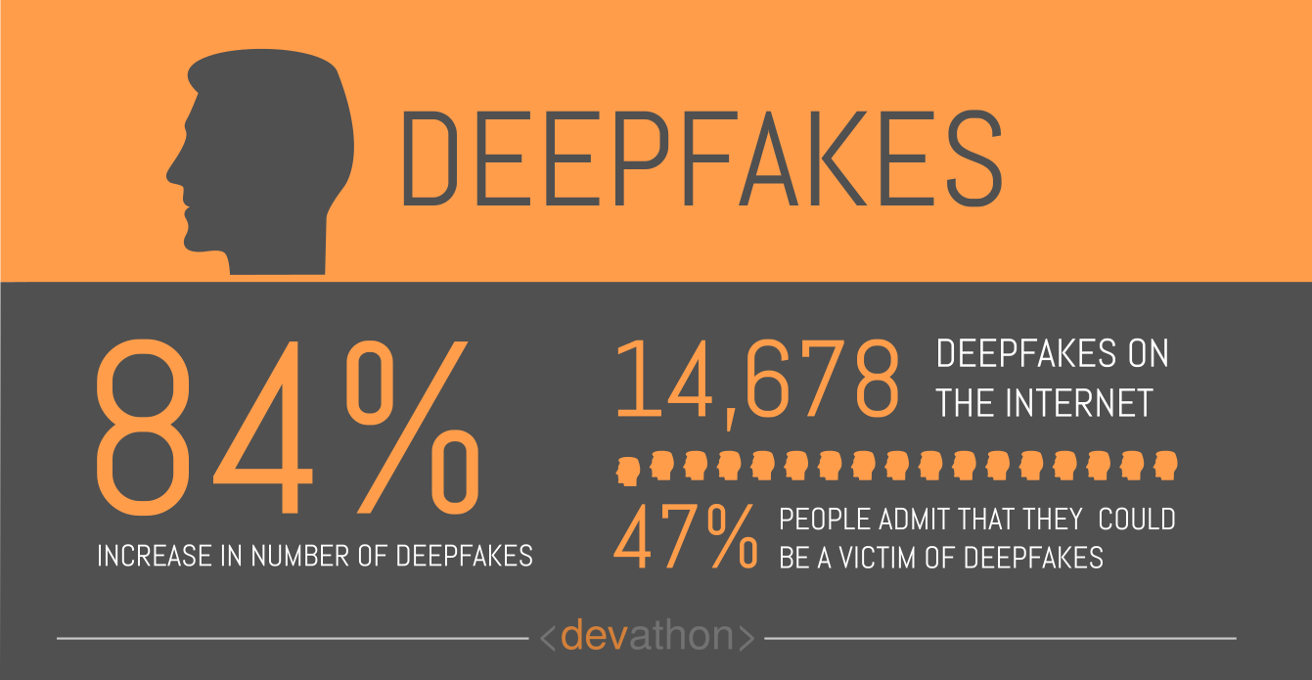
Statistics related to DeepFakes

Slide 9
Final Year Project
Deepfakes Text to Speech (TTS)
Deepcloning.AI

Slide 10
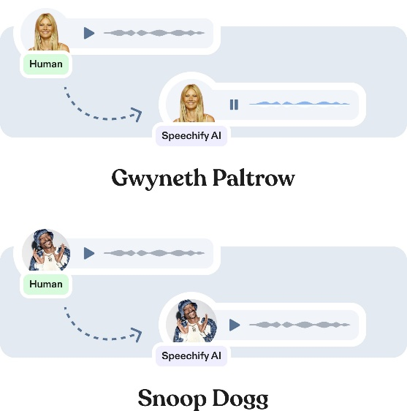
Our Projects Objectives
Our Project focus on Audio Deepfakes Creation, means user will provide an input in form of Text or Audio and our application will generate Audio deepfake as output.
Text to Speech: Text to speech means user provide its text as input and select language of text, according to it can select targeted person voice from provided options. After that, input text will be processed and output will be shown to user
Voice Cloning: voice cloning, which means user provide audio file using microphone or import file from device and select language of input audio, according to it can select targeted person voice from provided options. After that input audio will be processed and output will be shown to user.

Slide 11
Motivation behind Project
Motivation behind this project is that it’s a recent technology and lots of research paper are published related to deepfakes in recent years. Other Motivations are as below
Voice Cloning in Urdu: As there are lots of models available right now for developing Deepfake audio generation but still there is no significant work in Urdu language. So, we are working on creating English Deepfakes but after that our main focus is on developing a system for Urdu Deepfakes.
Deepfake audio detection: Right now, there is no accurate detection system available for Deepfake audio detection. So lot of room available to work on this field in future.
For assistance of Professionals : Developing a system for assistance for professionals like teachers. Yes there are lots of misuses of this technology, but it can be used for preparing a speech which can help in teaching, creating YouTube videos and etc.

Slide 12
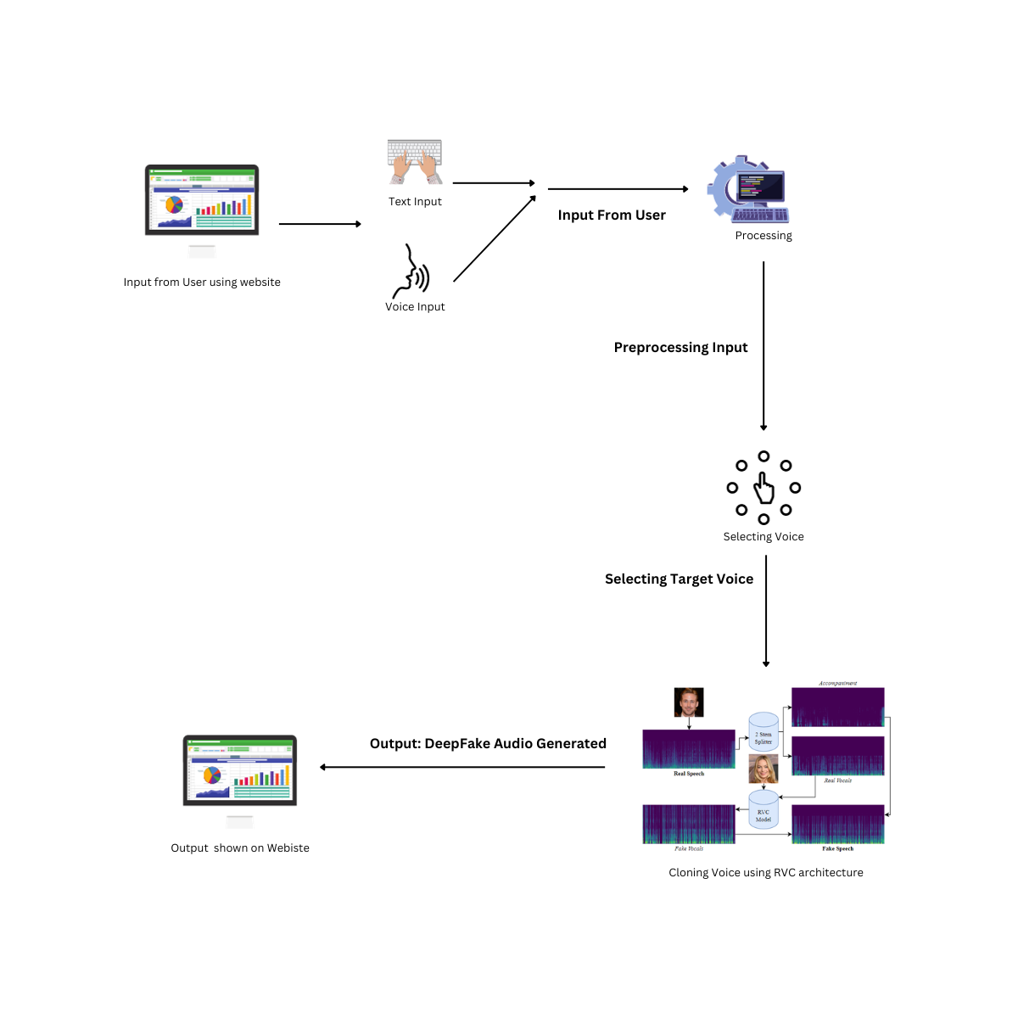
Architecture of our Project

Slide 13
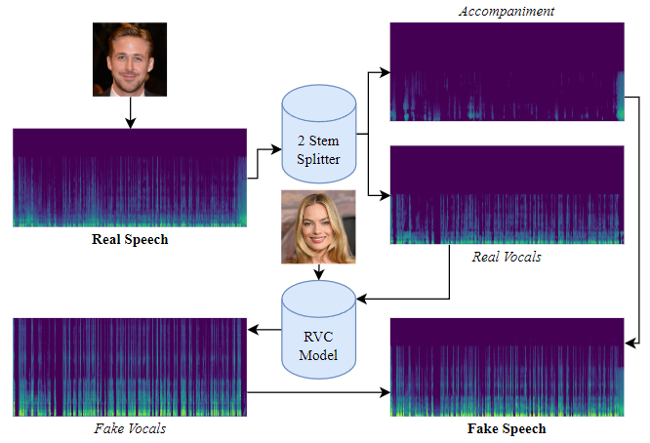
Retrieval-Based Voice Conversion (RVC) Model

Slide 14

Training the RVC model on Elon Musk dataset
So, we trained the RVC model on Elon Musk Dataset. After that using voice cloning system
we provided input as our speech and the model converts it into Elon musk Deepfake audio.
As, model is trained on smaller dataset (66 MB) so results are not promising.

Slide 15
Dataset Preparation Guide
Background Noise Removal
Reducing Echo
Voice Pitch in -12 to 12 HZ:
Vocal Segmenting
Vocal Isolation / Doubling
For Audio Processing, we will be using Python Libraries such as TorchAudio, PyAudio, Librosa (Audio Analysis)

Slide 16
DeepFakes
Thank You!

